Slide 1
ADProject July 22 2019

Slide 2
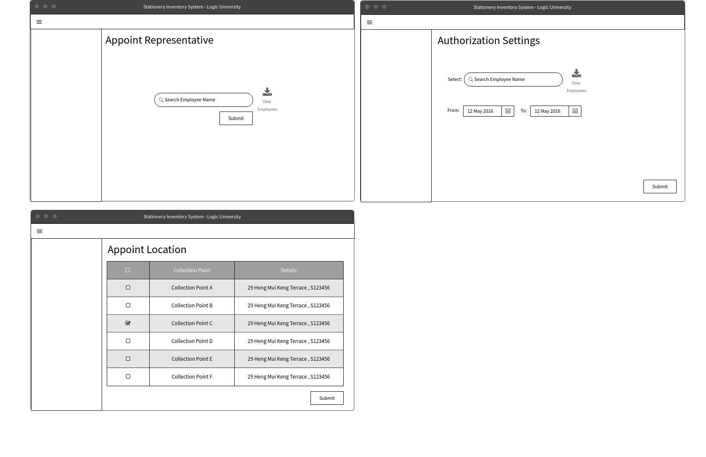

Slide 4


